Slide 1
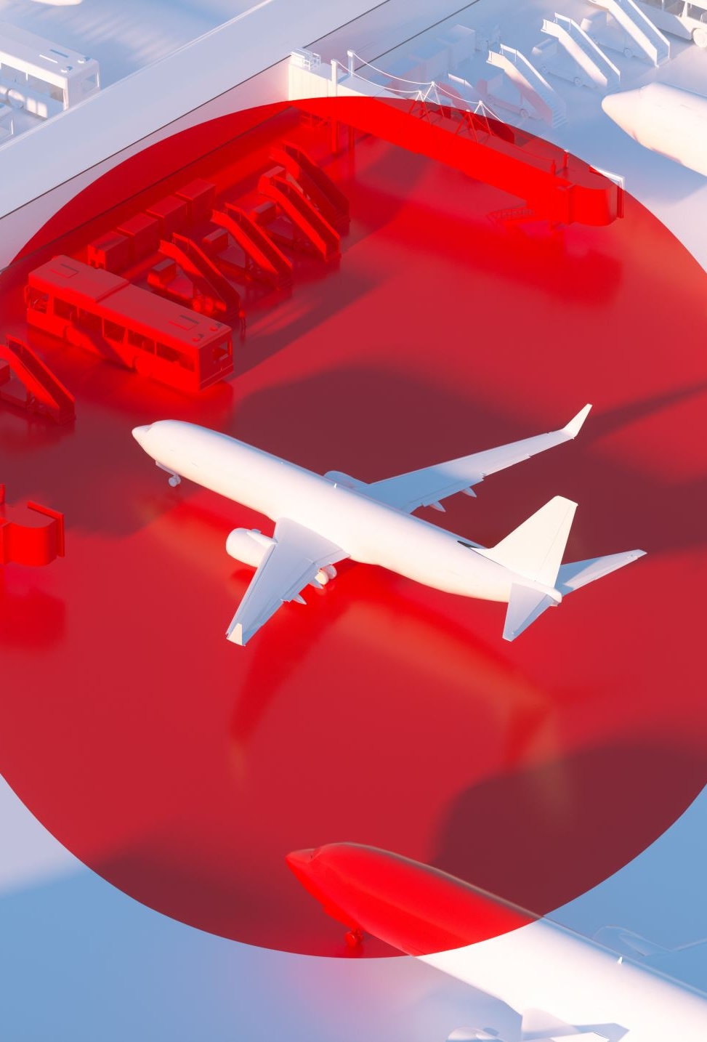
Twitter Sentiment Analysis of Airline Reviews
By
Sharan Kumar Reddy Kodudula

Slide 2
ABSTRACT
This study explores Twitter sentiment analysis of airline reviews, employing powerful ensemble methods for enhanced accuracy. By leveraging techniques like NLP and ensemble methods such as Bagging and Boosting, the research develops a robust model classifying tweets into positive, negative, or neutral sentiments. Results demonstrate that ensembles outperform individual classifiers, offering valuable insights for airlines to improve customer satisfaction.

Slide 3
INTRODUCTION
In today's digital era, social media platforms like Twitter serve as vibrant channels where people share their opinions, including experiences with airline services. Capturing the sentiment expressed in these tweets is invaluable for airlines aiming to enhance customer satisfaction. Traditional methods have limitations in handling the complexities of social media language. This study pioneers the application of ensemble methods – Bagging, Boosting in Twitter sentiment analysis of airline reviews. By leveraging the combined strength of these methods, this research aims to provide airlines with deeper insights into customer sentiments, facilitating more informed decision-making and improved service quality.

Slide 4
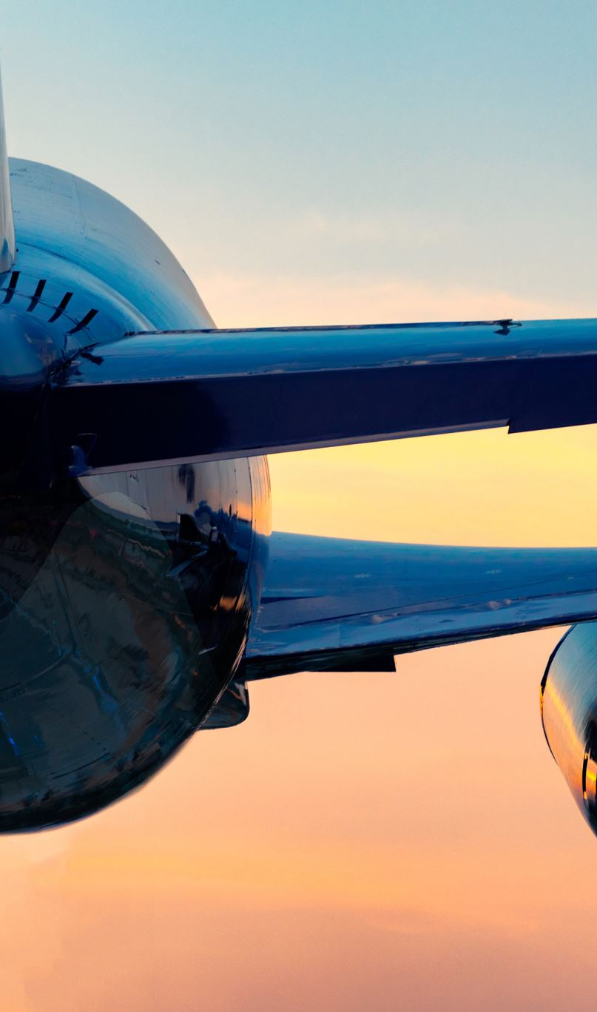
PROBLEM STATEMENT
Objective of the problem is to analyze Twitter sentiment related to airlines with the goal of understanding customer perceptions, identifying prevalent issues, and gauging overall customer satisfaction. By employing sentiment analysis techniques, this study aims to categorize tweets into positive, negative, or neutral sentiments, enabling airlines to proactively address concerns, enhance customer experience, and optimize their services based on real-time feedback.

Slide 5

LITERATURE REVIEW
Here, We have selected a base paper named “Airline passenger’s sentiment analysis for improving the quality of airline services by using a deep learning approach”.
In this paper they have used a machine learning-based method for tweets analyzing to improve customer experience handling.
The deep learning algorithm identifies ambiguous tweets and decides based on the level of ambiguity.
The results obtained from the deep learning algorithm validation show that the proposed method is able to identify passenger sentiments in a three-class analysis with 88.83% accuracy.

Slide 6

ABOUT DATASET
The data set used in the research is about the personal experiences of airline passengers, which is collected from Kaggle website.
Features included in this dataset are ‘tweet_id’, ‘airline_sentiment’,‘airline_sentiment_confidence’,‘negativereason’,‘negativereason_confidence’,‘airline’,‘airline_sentiment_gold’,‘name’ ,‘negativereason_gold’,‘retweet_count’,‘text’,‘tweet_coord’, ‘tweet_created’, ‘tweet_location’, ‘user_timezone’.
The collection of research data includes 14,640 tweets from 7700 passengers.
The airlines included are Virgin America, Delta, SouthWest, US Airways, United, American.

Slide 7

METHODOLOGIES
Importing Libraries
Loading the data
Balancing the dataset
Loading the ensemble models
Train and load the models
Compile the model for classification
Classify the models and predict the output
Save the model

Slide 8

Step:1 (Importing Libraries)
Numpy
Pandas
Scikit-learn
Collections Module
Requests Module
NLTK
Imblearn
Step:2 (Loading the data)
Python has a built-in head () function to read a file. This function returns a file object, also called a handle, as it is used to read or modify the file accordingly. We can specify the mode while opening a file. In mode, we specify whether we want to read, write or append to the file. We can also specify if we want to open the file in text mode or binary mode.

Slide 9
Step:3 (Balancing the dataset)
Here the dataset which we have taken is imbalanced so we balance the dataset using SMOTE(Synthetic Minority Oversampling Technique) analysis. We used two techniques to balance the dataset Over Sampling and Under Sampling.
Step:4 (Loading Ensemble Methods)
We have used ensemble methods to predict whether the data in twitter about the airlines review given is accurate or not. We have used five different models to check the accuracy. They are Averaging Method, Max Voting, Bagging, Boosting, KNORA-E.

Slide 10
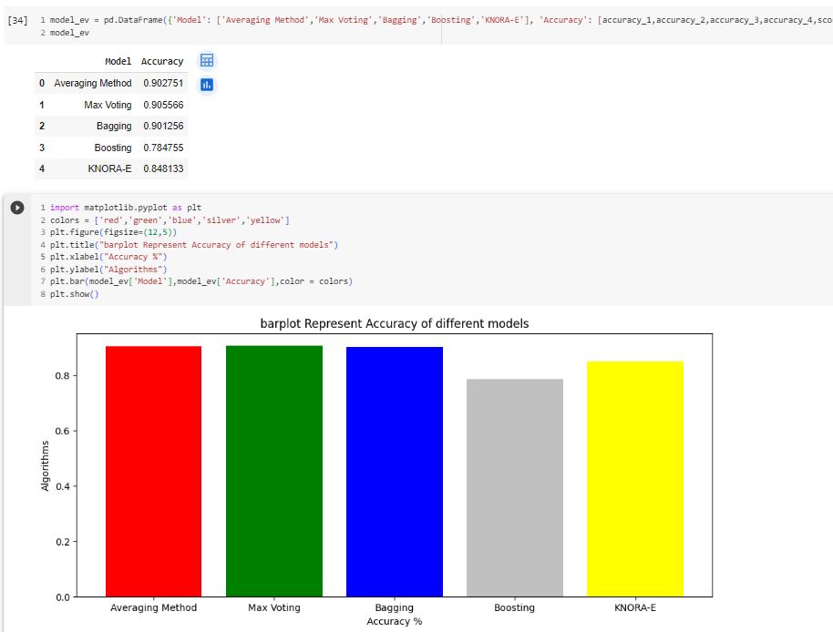
Results:
In the algorithms used, Max Voting method has the best accuracy that means it is giving the best accurate analysis of the sentiment of the passengers of the airlines.

Slide 11
Conclusion:
Using ensemble techniques, specifically Max Voting, produced remarkably accurate results in our sentiment analysis of airline passengers on Twitter. This cooperative strategy, which combined various models, gave rich insights regarding passenger attitude that are essential for improving airline services. Airlines were able to address customer issues and build closer relationships by leveraging the strength of ensemble approaches, which demonstrated an ability to interpret complicated feelings. This study highlights Max Voting's efficacy and emphasizes the value of continuous analysis in order to adjust to changing consumer emotions in the ever-changing world of social media.

Slide 12

THANK YOU!!

